Slide 1
WEB 322 WEB PROGRAMMING TOOLS AND FRAMEWORKS
WEEK 1 - LECTURE 2
ECMAScript 2015 / ES6

Slide 2

The Era of Browser Wars

Slide 3
The history of JavaScript
1995: Brendan Eich, an engineer in Netscape created a language that could make static web pages “live” and more interactive. That language was called LiveScript.
1996: The “language” was changed from LiveScript to JavaScript as a marketing strategy because during this time Sun Microsystem’s Java language was a very popular programming language, despite the two having very little in common.
1996 (a couple months later): Microsoft released JScript with Internet Explorer
1997: Netscape submitted the language to ECMA International to have the language standardized.

Slide 4
The history of JavaScript
1997: The language was standardized and ES1 (ECMAScript 1) was born.
2009: ES5 (ECMAScript 5) was released with a lot of new features.
2015: ES6 (ECMAScript 2015) was released with the biggest update to the language ever.

Slide 5
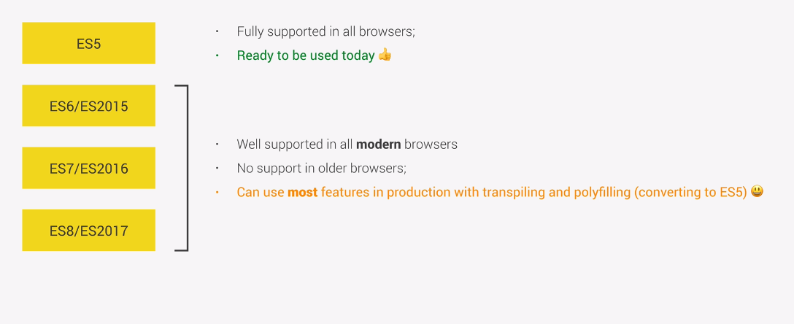
Versions of JavaScript

Slide 6

Reasons to learn ES6
JavaScript isn’t a perfect language, it has several flaws, mainly because the language was built very quickly. ES 6 improves on a lot of the flaws of the prior version(s).
It is backward compatible, meaning that once something is accepted as valid JS, there will not be a future change to the language that causes that code to become invalid JS.
Most, if not all modern browsers and environments support it.
Stats Indicating the usage of Browsers: https://www.w3counter.com/globalstats.php
HTML, CSS, & JS features that are supported across various browsers: https://caniuse.com/

Slide 7
What about Internet Explorer?

Slide 8


Dealing with old browsers
If you absolutely need to support older browsers, then you could use transpilers, example Babel.
Transpilers: source-to-source compilers. They are tools that read source code written in one programming language, and produce the equivalent code in another language. Languages you write that transpile to JavaScript are often called compile-to-JS languages, and are said to target JavaScript.

Slide 9
Some new features of ES6
Variable Declarations with let and const
Template Literals/Template Strings
Arrow Functions
Default Parameters
Destructuring
Classes and Subclasses
Arrays (new methods)
Rest and Spread Operators
Promises
Modules

Slide 10
Variable Declarations with let and const
ES2015 introduced two important new JavaScript keywords: let and const.
These two keywords provide Block Scope variables (and constants) in JavaScript.
Before ES2015, JavaScript had only two types of scope: Global Scope and Function Scope.
The keyword var hoists (pushes variable declarations to the top of the file) variables to the top whereas, let and const does not.

Slide 11
Template Literals/Template Strings
Template literals are string literals allowing embedded expressions.
Template literals are enclosed by the back-tick (` `) character instead of double or single quotes.
We don’t have to use the plus (+) operator to concatenate strings, or when we want to use a variable inside a string
Template literals can contain placeholders. These are indicated by the dollar sign and curly braces (${expression}).
let s = `My name is ${firstName} ${lastName}.`

Slide 12
Arrow Functions
Arrow functions allow us to write shorter function syntax (in some circumstances).
The handling of the this keyword is also different in arrow functions compared to regular functions.
In short, with arrow functions there are no binding of this.
In regular functions the this keyword represents the object that called the function, which could be the window, the document, a button or whatever.
With arrow functions the this keyword always represents the object that defined the arrow function.

Slide 13
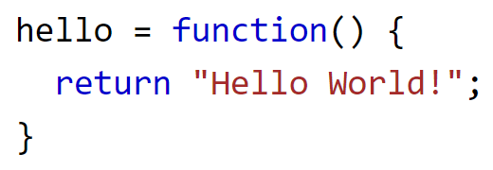
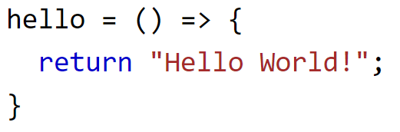
Arrow Function Examples
Before:
After:
https://www.w3schools.com/js/js_arrow_function.asp

Slide 14
Default Parameters
This feature allows you to assign default values to parameters.
When you run your function with a missed argument, it will take the value of the default parameter, and it will not return an error.

Slide 15
Destructuring
An assignment syntax that makes it possible to unpack values from arrays, or properties from objects, into new variables easier.

Slide 16
Classes
In ES5 there were no concepts of classes. If you wanted to create several objects of a particular type, you would be required to create something called a Constructor function first. For many developers, the concept was confusing as it deviated from traditional OOP which required classes to create objects.
ES 6 introduced classes, allowing you to define a class with a constructor method and then create objects from the class by invoking the constructor with the new keyword.

Slide 17
Arrays (new Methods)
Maps: Creates a new array populated with the results of calling a provided function on every element in the calling array.
For Each: Executes a provided function once for each array element.
Find: Returns the value of the first element in the provided array that satisfies the provided testing function.
Filter: Creates a new array with all elements that pass the test implemented by the provided function.

Slide 18


